Slide 1
WEB PROGRAMMING TRANING
BY
A.D. Adekale, Ja’afar Sadiq, Muhammed B. Ibrahim, Erasmus O. Edward

Slide 2
DAY 6. html project

Slide 3
*STEP ONE
Basic HTML Structure
* <!DOCTYPE html>
* <html>
* <head>
* <title>HTNL PROJECT</title>
* </head>
* <body>
* This is my first HTML page!
* </body>
* </html>

Slide 4

STEP .2 (header section)
Upload a logo image with an id top( <img src="" alt="">
Create a list of the following links to page(<a href=""></a>
HOME
REGISTER
CONTACT

Slide 5
Step .3
Heading 1 with the name of the web site
Upload An image with a full size width
Add a paragraph with information about the page

Slide 6

Step .4
Within a paragraph each upload an image , audio and a video
Add information about each
<img src="" alt="">
<audio src=""></audio>
<video src=""></video>

Slide 7
Step .5
Create two link BACK TO TOP and ABOUT in the footer section
Create a page ABOUT containing information about the entire web site

Slide 8
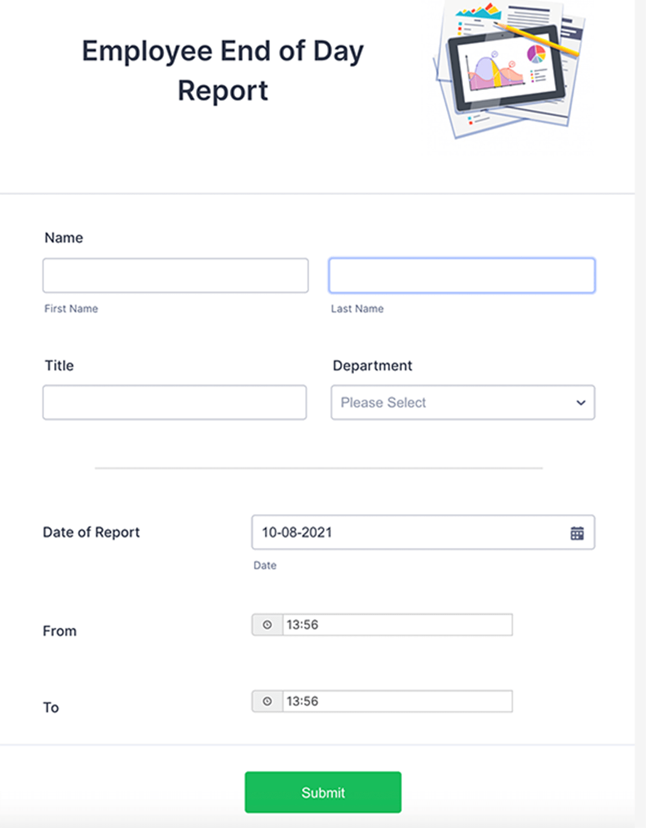
Step .6
Create a new page register with a complete form in it

Slide 9
Step .7
Create a page CONTACT with a table of contact location in different places

Slide 10
NOTE
Make sure all pages are connected to their corresponding link on the home page

Slide 11
THANK YOU.

